Slide 1


Social Buzz
Social media & content creation

Slide 2


Today's agenda
Project recap
Problem
The Analytics team
Process
Insights
Summary

Slide 3

Social Buzz is a fast growing technology unicorn that need to adapt quickly to it’s global scale.
Accenture has begun a 3 month POC focusing on these tasks:
An audit of Social Buzz’s big data practice
Recommendations for a successful IPO
Analysis to find Social Buzz top 5 most popular categories of content.
Project Recap

Slide 4

Problem
Over 100000 posts per day
36,500,000 pieces of content per year!
But how to capitalize on it when there is so much?
Analysis to find Social Buzz’s top 5 most popular categories of content

Slide 5


Andrew Fleming
Chief Technical Architect
The Analytics team
Marcus Rompton
Senior Principle
ME
Kartik Upadhyay
Data Analyst

Slide 6
Project Process
1
Data Understanding
2
Data Cleaning
3
Data Modelling
4
Data Analysis
5
Uncover Insights

Slide 7
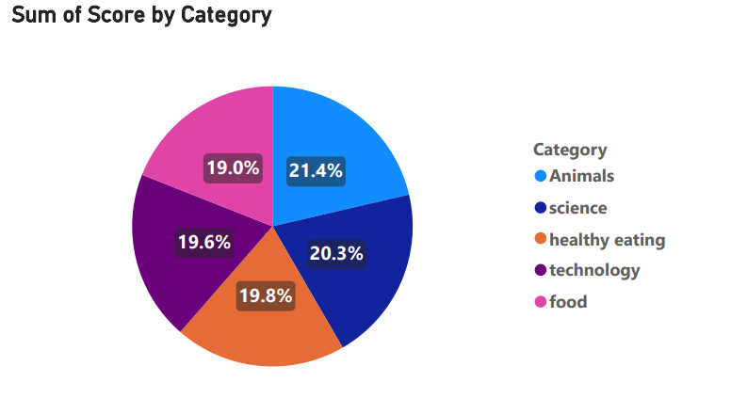

Insights:
The top 5 category with their content score.
Separated by percentage sorting in decreasing order in clockwise direction.

Slide 8
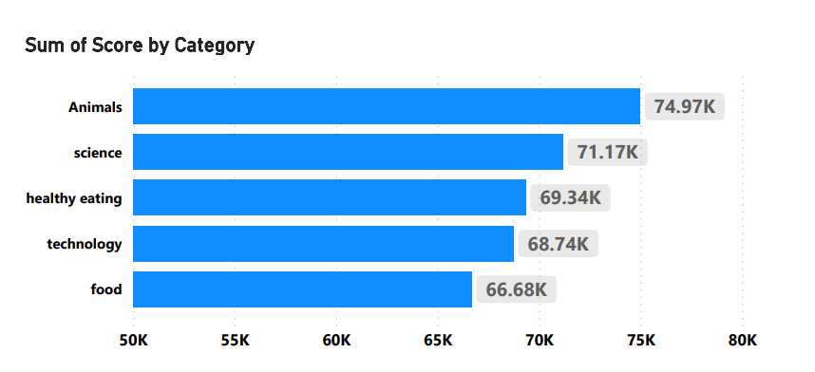
Top 5 content category with their content score
Top First content category is Animals with a content score ~74.97k

Slide 9

Summary
The top 5 content category with their content score (in Thousands):
1. Animals (74.97)
2. Science (71.17)
3. Healthy eating (69.34)
4. Technology (68.74)
5. Food (66.68)
Sorted in decreasing order with their content score.
Animals have the highest score of 74.97k

Slide 10
Thank you!
ANY QUESTIONS?

